Slide 1

P-194- Patients Condition Classification Using Drug
Reviews
PROJECT BY :
1. Mr. Abhishek Devanand Karande
2. Mr. rushil Rajendra dumbre
3. Mr. Deepak mahtha
4. Mr. Nihal Mehboob Mulani
5. Mr. Ajinkya Rajendra Bhandarge
6. Mr. Abhineeth HR

Slide 2
Contents
Overview
Business Objective
Data Collection & Details
Exploratory Data Analysis
Visualizations
Modeling
Evaluation
Deployment
Result and Evaluation
Future Work
Conclusion

Slide 3
OVERVIEW :
The objective of the project is to predict patient conditions based on reviews and suggest appropriate drugs.
The benefits of the project include improved patient outcomes, reduced healthcare costs, and increased efficiency.
The methodology used for the project involved data collection, data analysis, and machine learning.

Slide 4
Business Objective :
This is a sample dataset which consists of 161297 drug name, condition reviews and ratings from different patients and our goal is to examine how patients are feeling using the drugs their positive and negative experiences so that we can recommend him a suitable drug. By analyzing the reviews, we can understand the drug effectiveness and its side effects.
The dataset provides patient reviews on specific drugs along with related conditions and a 10 star patient rating reflecting overall patient satisfaction.
So in this dataset, we can see many patients conditions but we will focus only on the below, classify the below conditions from the patients reviews
a. Depression
c. High Blood Pressure
d. Diabetes, Type 2

Slide 5
FLOWCHART OF PROJECT:
PROJECT
EDA
MODEL BUILDING
MODEL EVALUATION
DEPLOYMENT
PRESENTATION

Slide 6
DATA COLLECTION :
The data was collected from an online healthcare platform.
The dataset includes patient reviews, demographics, and medical histories.
Data cleaning and preprocessing involved removing duplicates, filling in missing values, and normalizing the data.

Slide 7
DATA DETAILS :
13944 rows & 8 column
Attribute Information:
1. DrugName (categorical): name of drug
2. condition (categorical): name of condition
3. review (text): patient review
4. rating (numerical): 10 star patient rating
5. date (date): date of review entry
6. usefulCount (numerical): number of users who found review useful

Slide 8
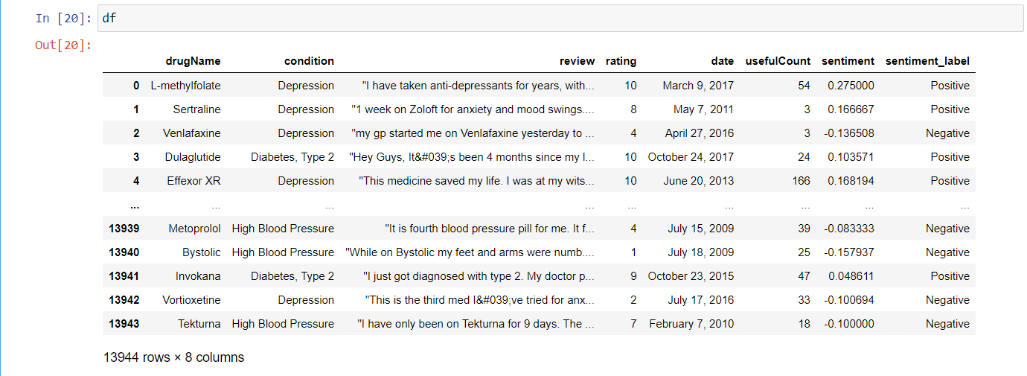
Data Sample:

Slide 9
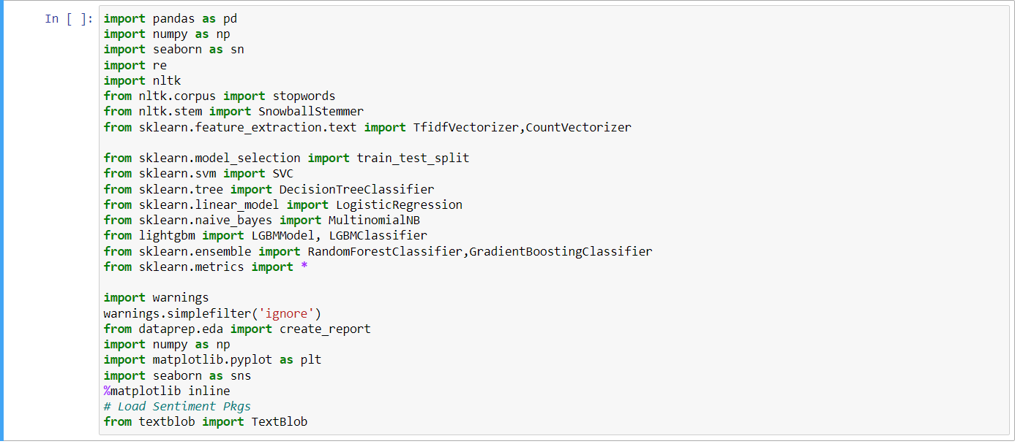
Importing Libraries

Slide 10

Exploratory Data Analysis (EDA)

Slide 11
#EDA
Exploratory data analysis was conducted to gain insights into the patient conditions and identify patterns in the reviews.
Analysis included distribution of patient conditions, most common words in reviews, and sentiment analysis.
Visualization of data was done using bar charts and word clouds.

Slide 12
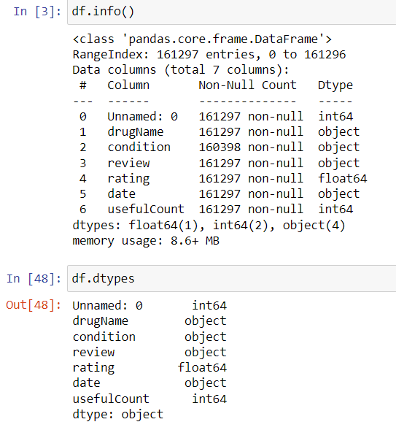
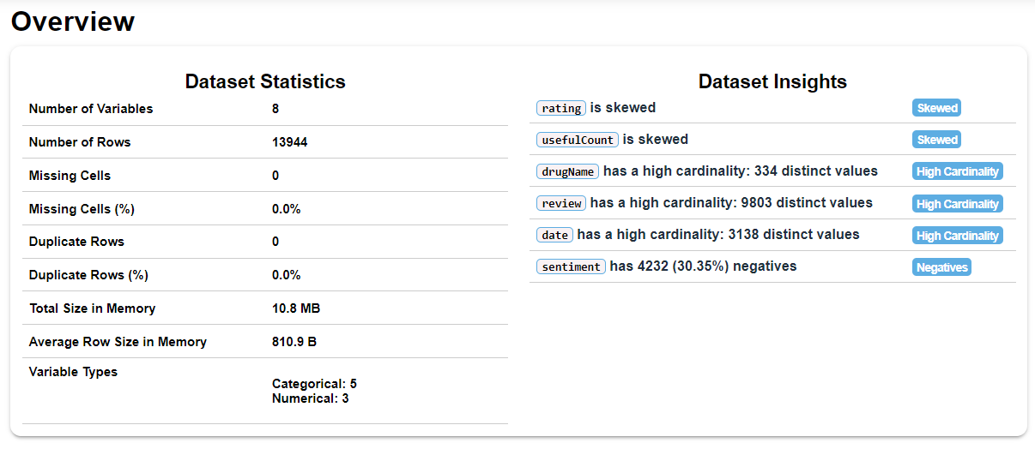
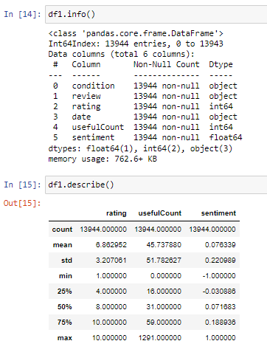
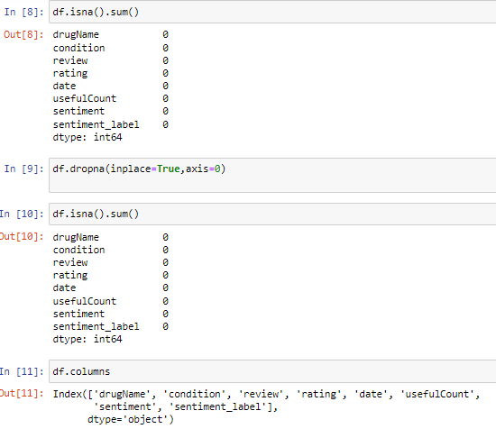

Slide 13
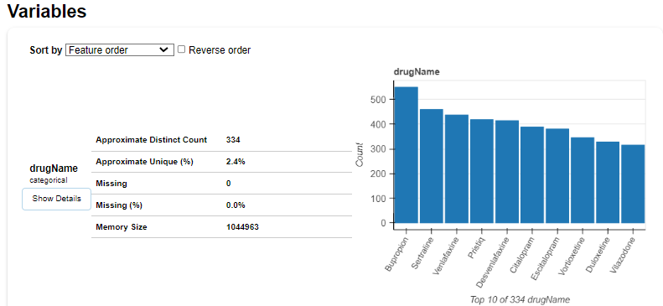
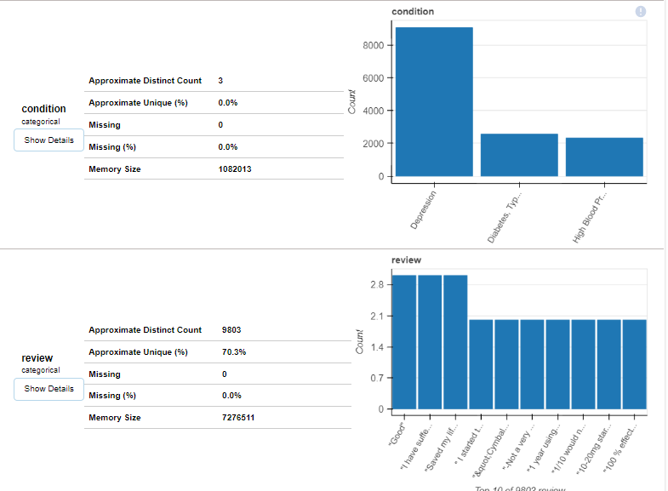
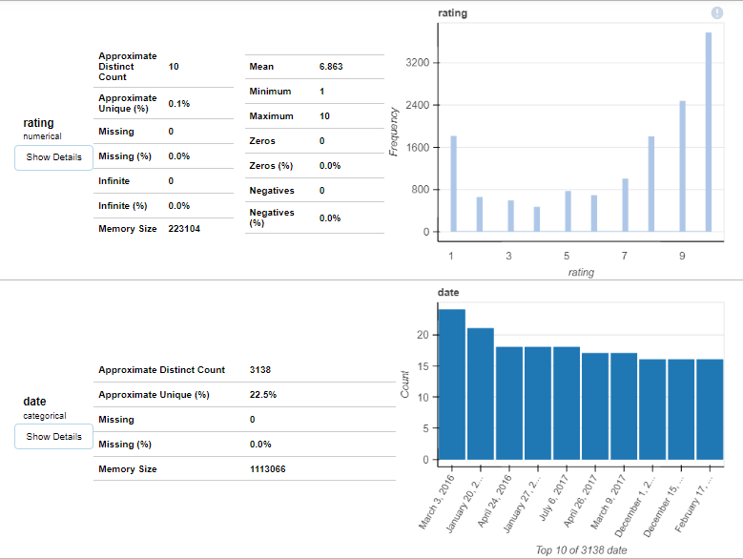
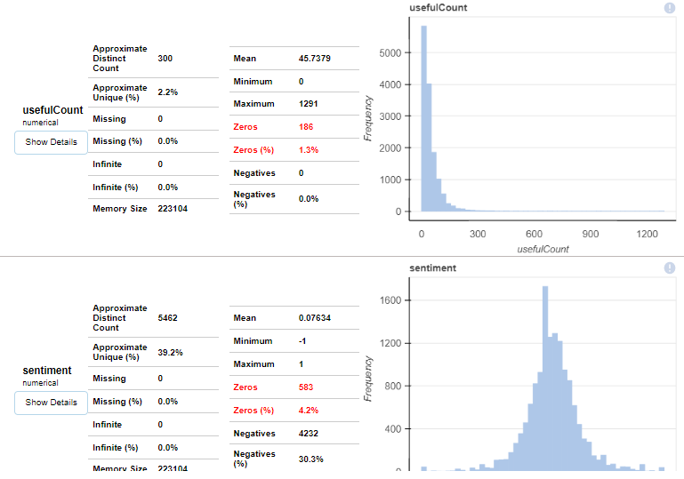
VISUALISATION :

Slide 14
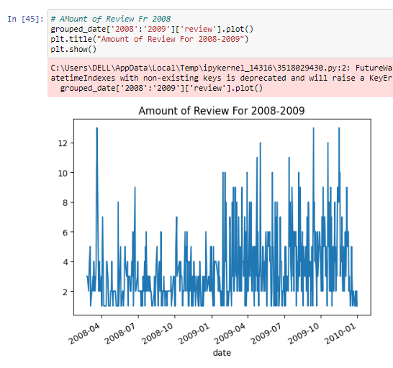
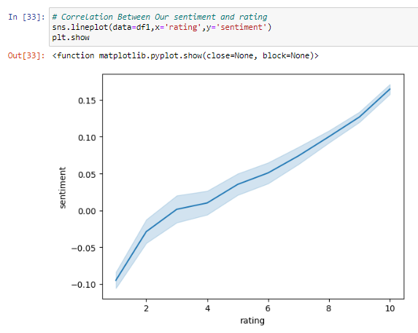
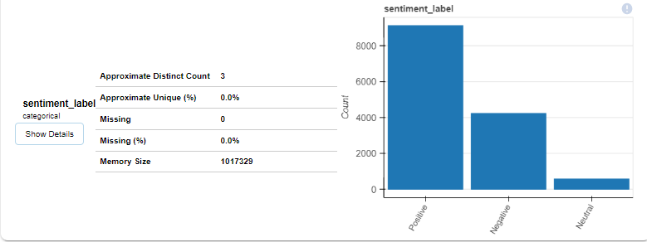
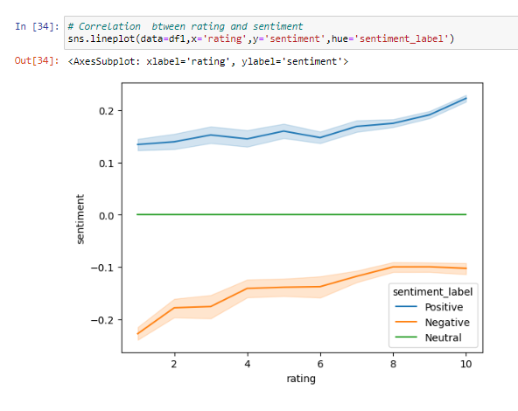
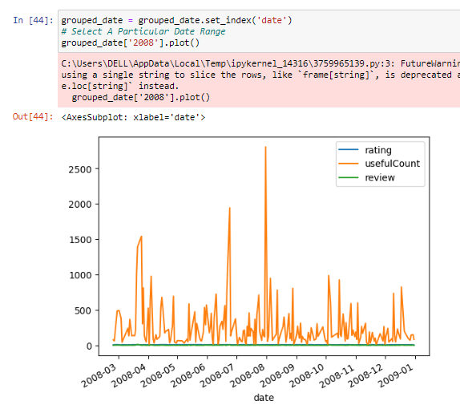
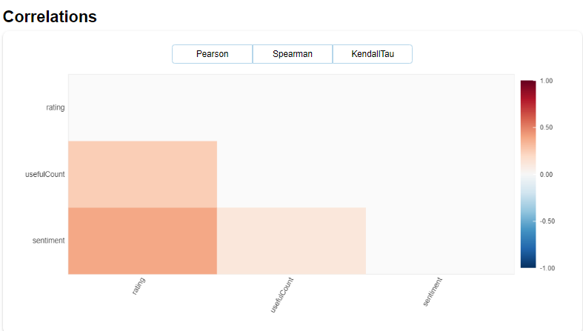
VISUALISATION :

Slide 15
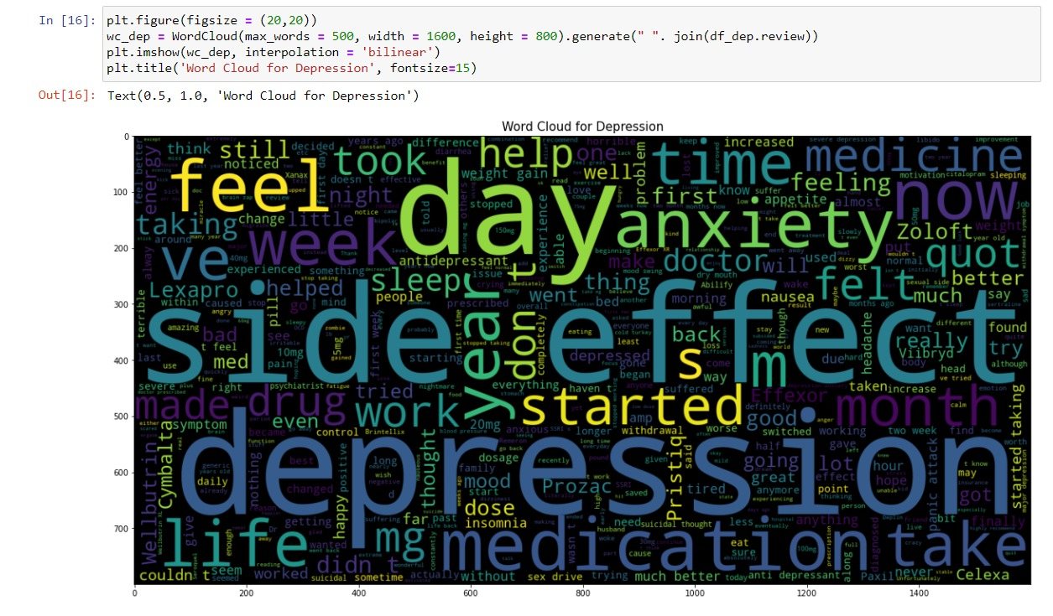
Wordcloud:

Slide 16
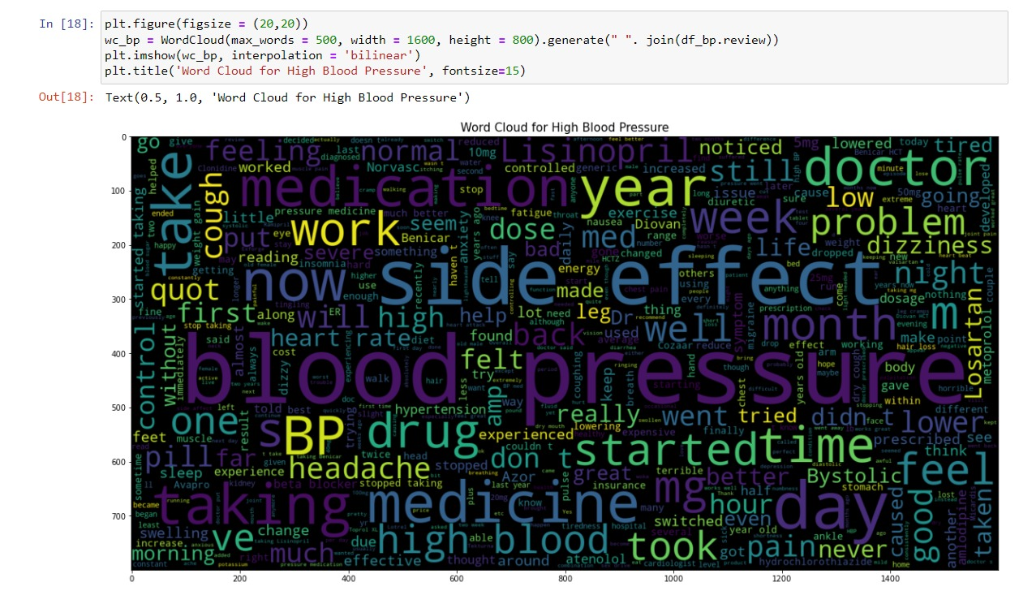
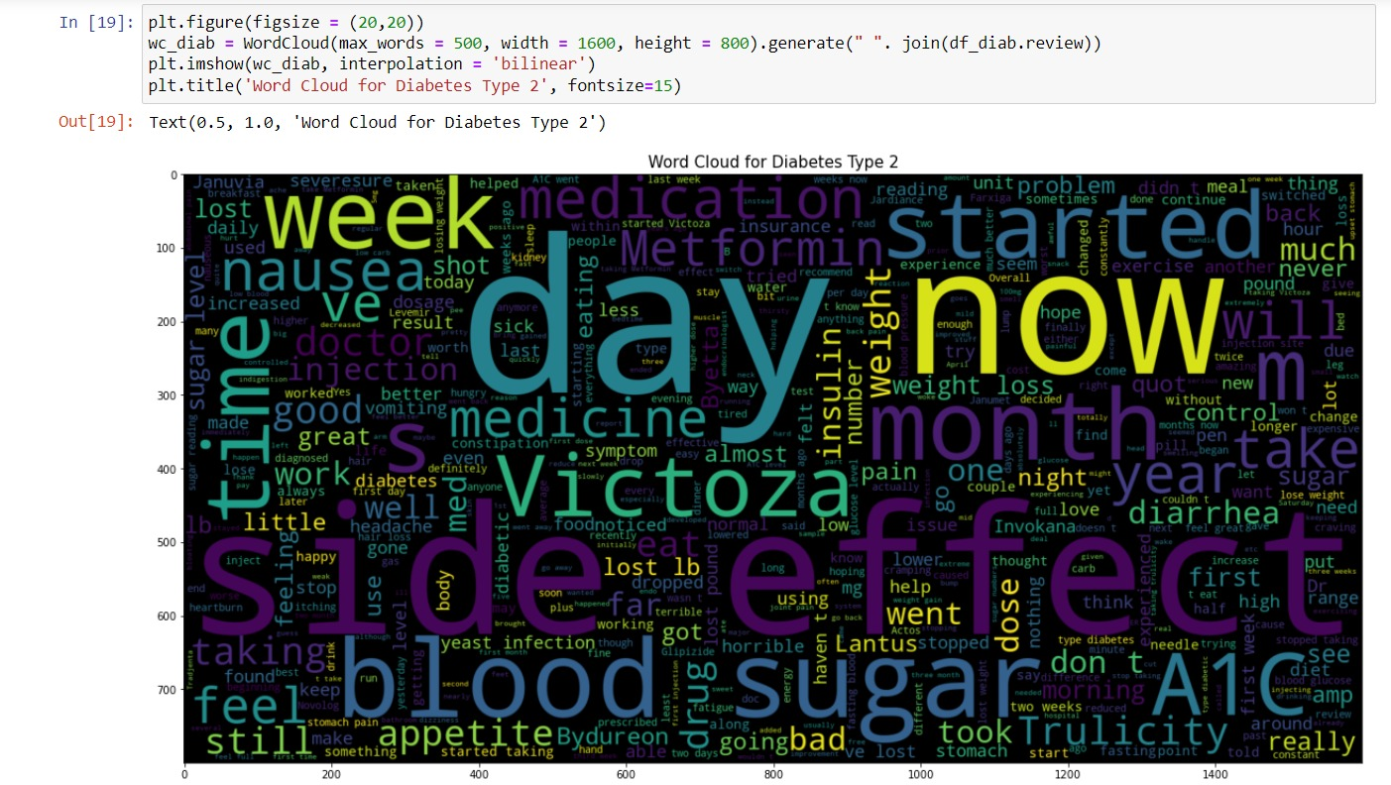

Slide 17
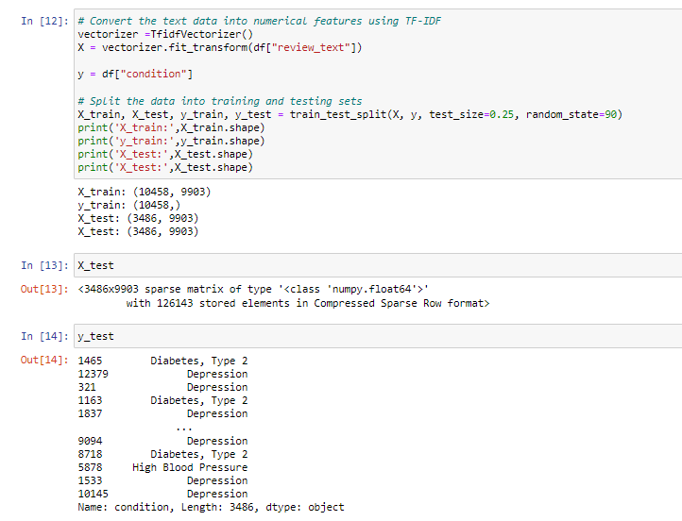
SPLITTING THE DATA SET INTO TRAIN TEST

Slide 18
MODEL BUILDING :
The machine learning models used are LOGISTIC REGRESSION, SVM, LGBM, NAÏVE MODEL, DECISION TREE, RANDOM FOREST, GRADIENT BOOSTING MODEL.
The algorithm was trained on 75% of the data and tested on the remaining 25%.
The most accurate model we get have a accuracy of 95%.

Slide 19
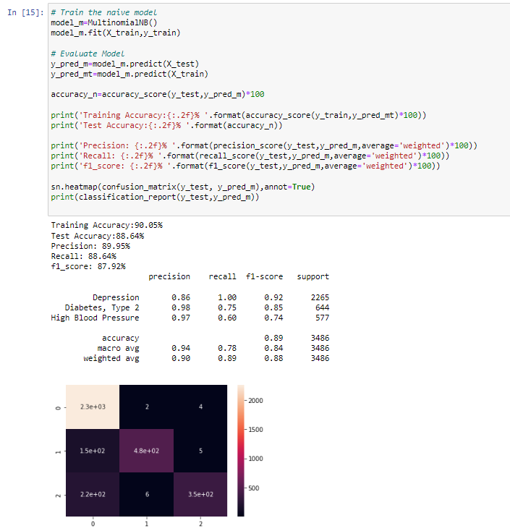
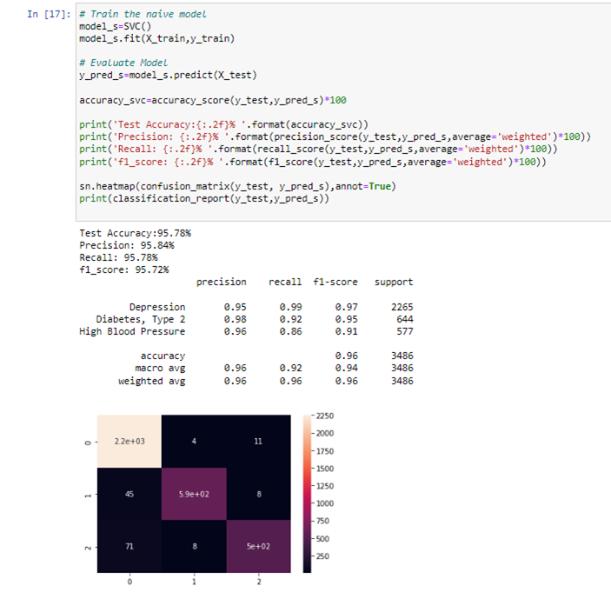
1. NAIVE MODEL :

Slide 20
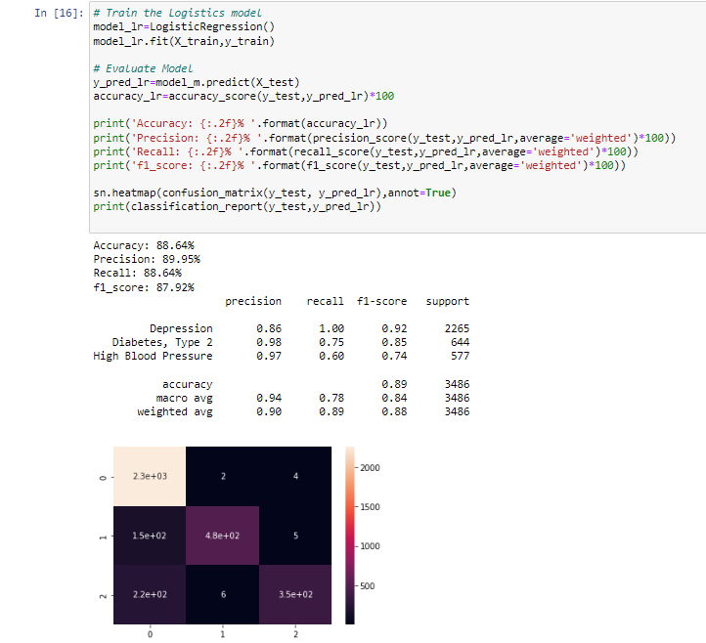
2. LOGISTIC MODEL :

Slide 21

3. DECISION TREE :

Slide 22
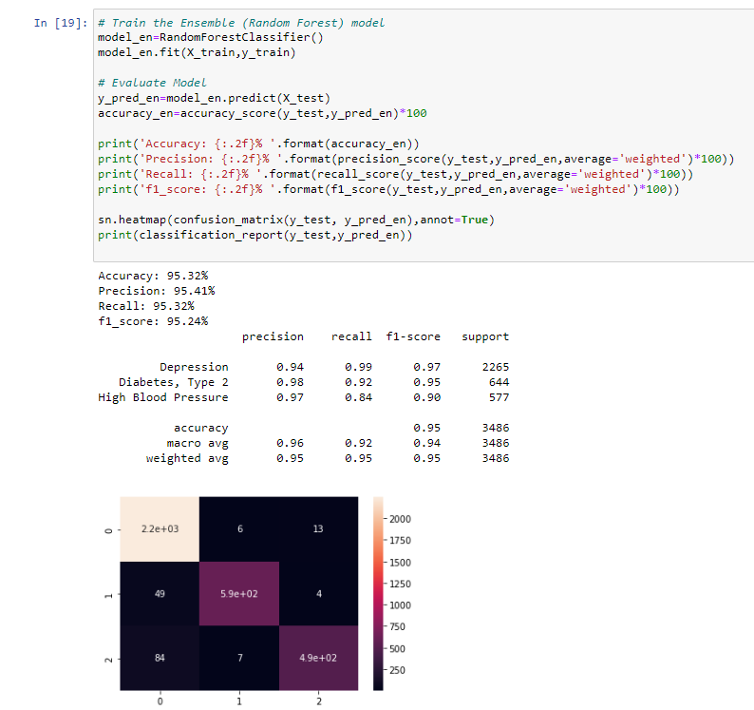
4. RANDOM FOREST :

Slide 23
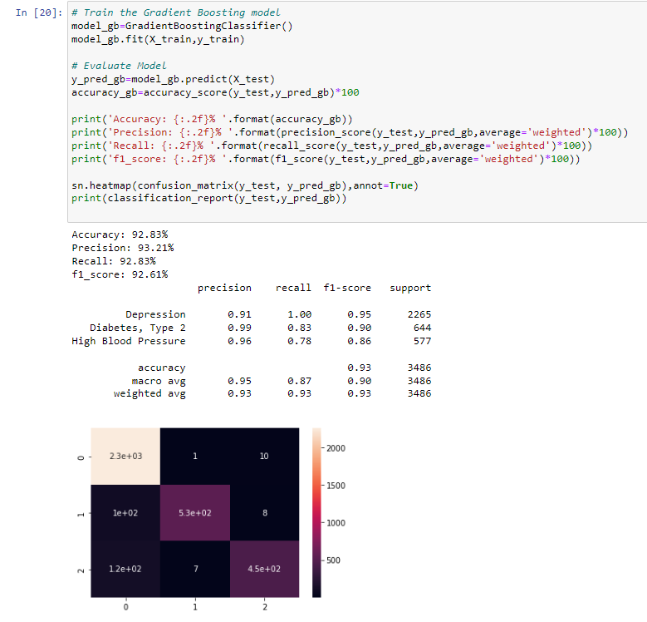
4. GRADIENT BOOSTING MODEL :

Slide 24
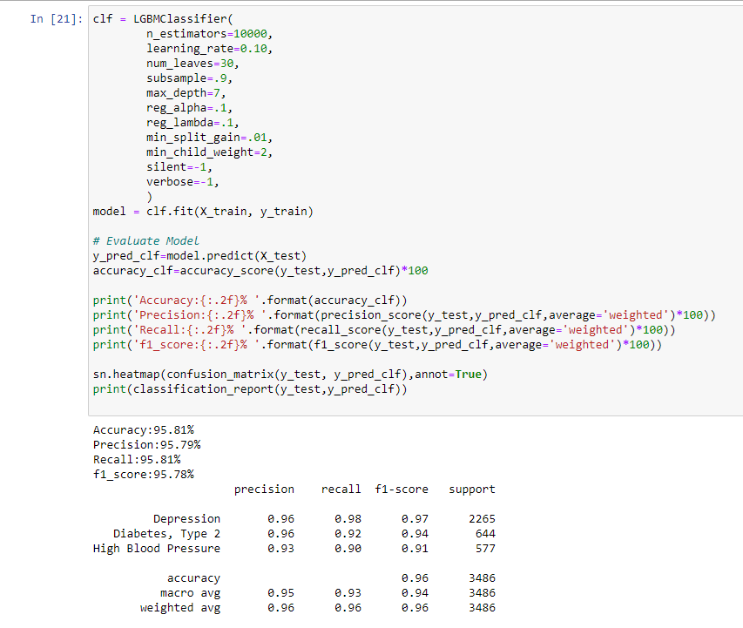
6. LGBM CLASSIFIER :

Slide 25
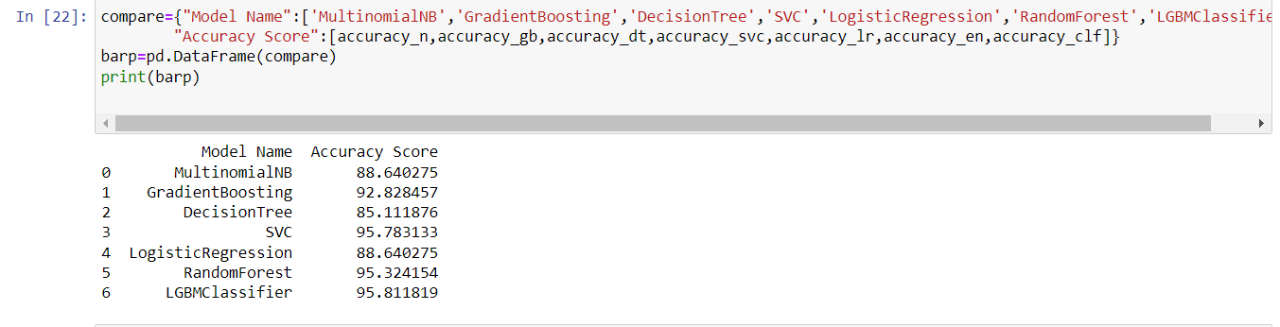
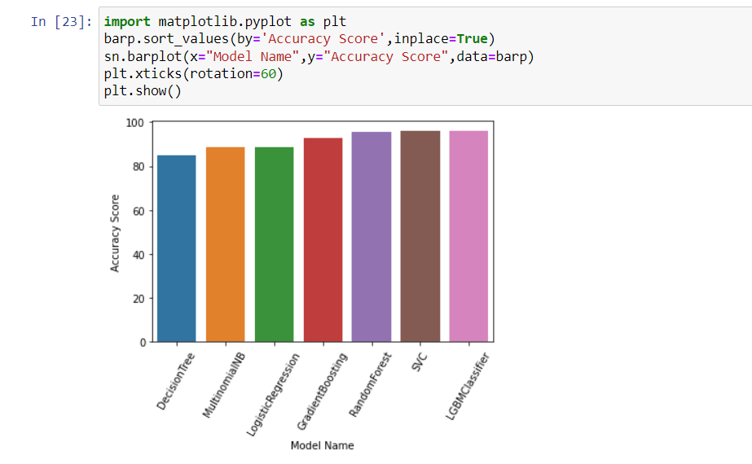
COMPARING THE MODELS :

Slide 26

Deployment :

Slide 27
The drug suggestion system
The drug suggestion system was based on SVM algorithm.
The algorithm took into account patient condition, medical history, and drug interactions.
The accuracy of the system was 95%

Slide 28
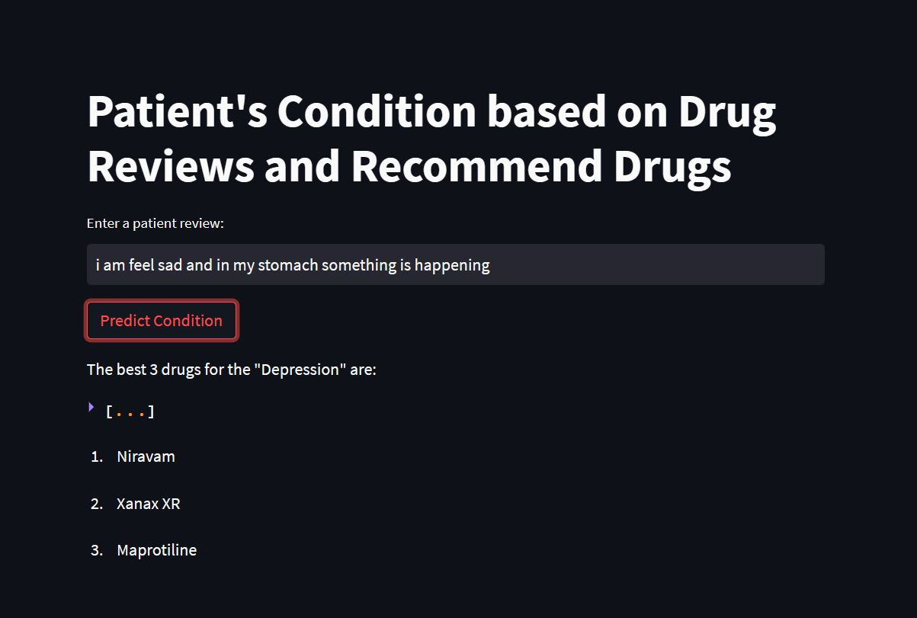
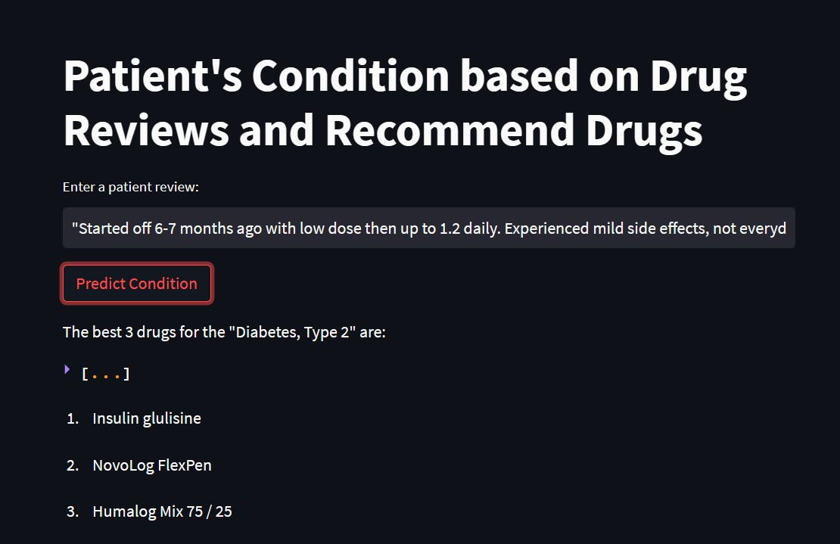
DEPLOYMENT :
Case 1 : Depression
Case 2 : Diabetes

Slide 29
Results and Evaluation
The results showed that the machine learning model and drug suggestion system were effective in predicting patient conditions and suggesting appropriate drugs.
Evaluation metrics used included accuracy, precision, and recall.
Limitations of the project included the size of the dataset and the lack of diversity in patient demographics.

Slide 30
Future Work
Future work could include incorporating more data sources to increase the size and diversity of the dataset.
Improvements could also be made to the machine learning model and drug suggestion system to increase accuracy and efficiency.

Slide 31
CONCLUSION :
In conclusion, the project was successful in predicting patient conditions and suggesting appropriate drugs.
The project has important implications for the healthcare industry and has the potential to improve patient outcomes and reduce healthcare costs.

Slide 32


